Slide 1
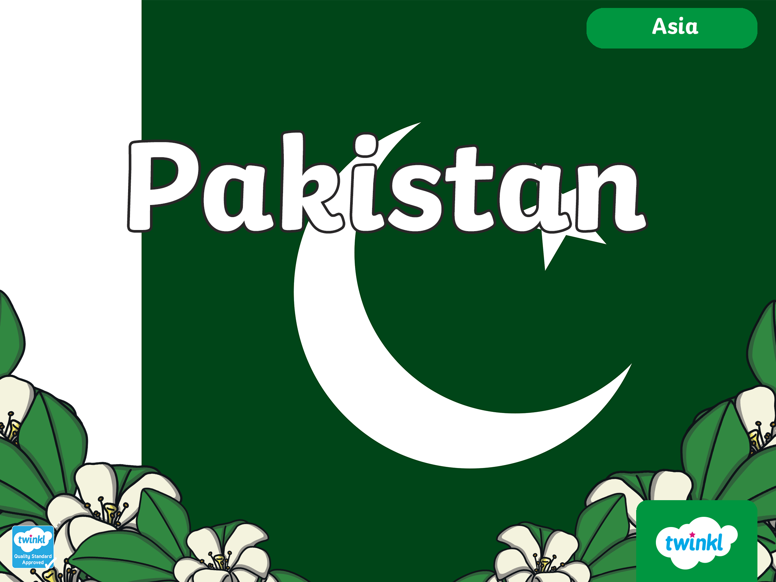

Slide 2
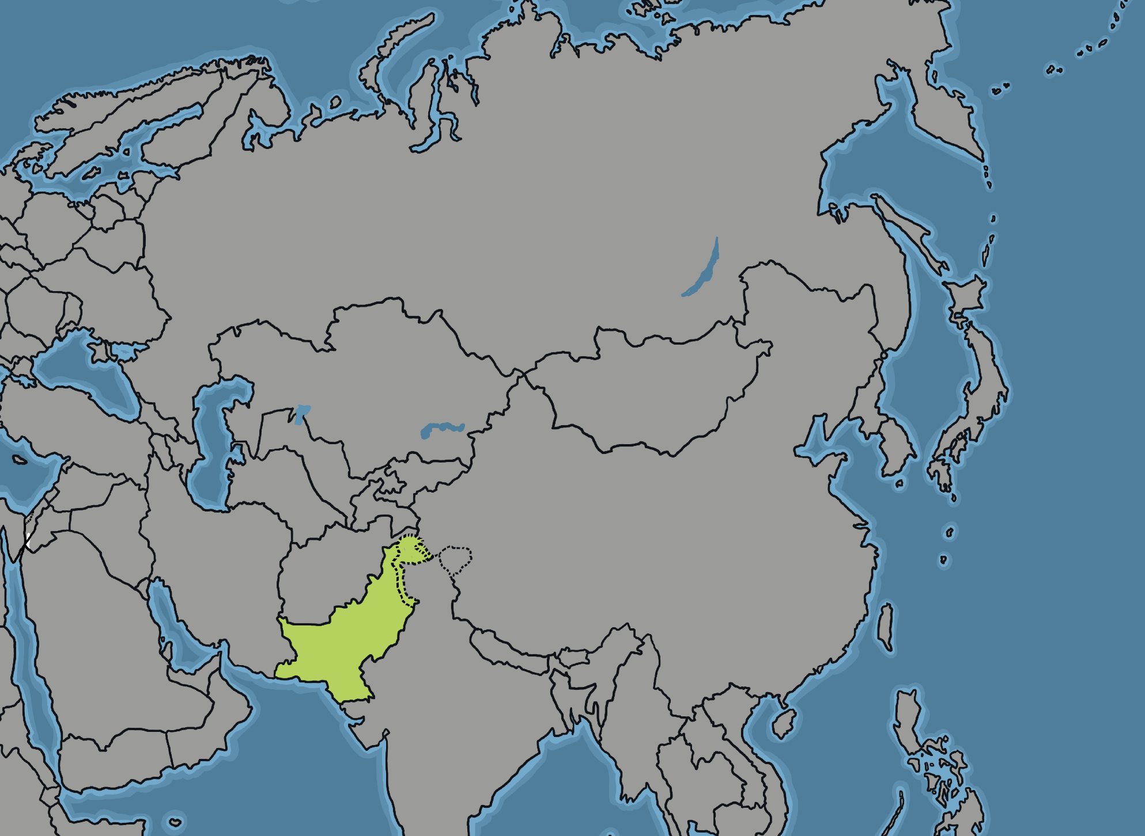
Where is Pakistan?

Slide 3
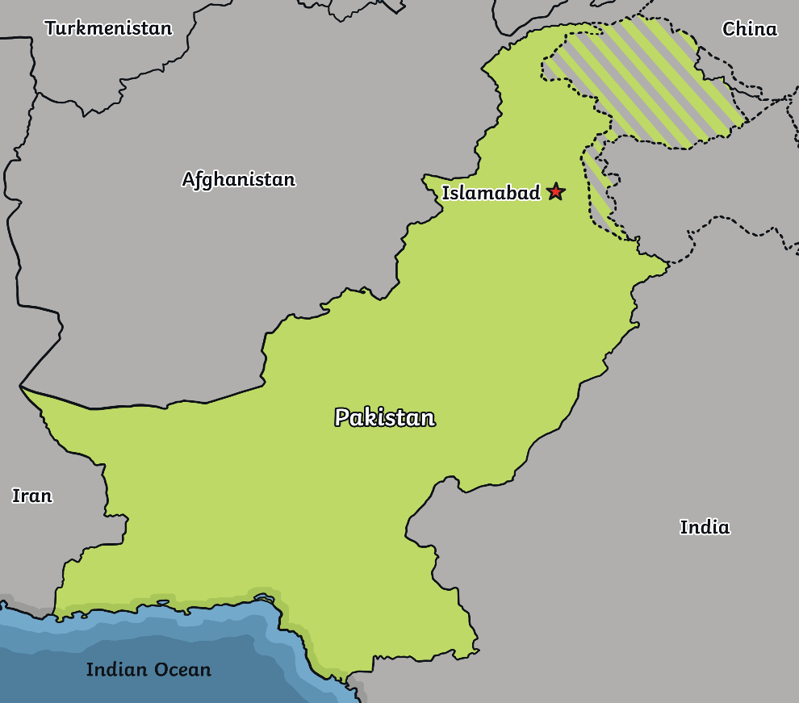

Where is Pakistan?
  Quick Facts
Capital City: Islamabad
Population: over 245 million people (2024)
Currency: Pakistani rupee
Official Languages: English and Urdu
Flag

Slide 4
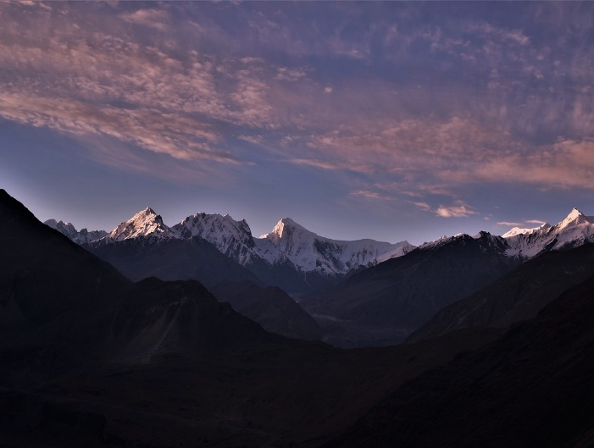

What is the climate like?
It is mostly hot and dry in the desert regions.
It is very cold in the north in the winter.

Slide 5
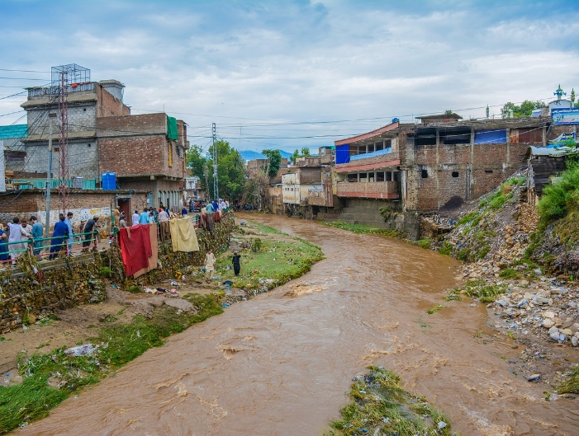
What is the climate like?
There can be drought and flooding.
Drought is when there is no rain for a long time. The ground gets very hard.
It is then too dry to soak up all of the water when there is heavy rain. This can cause floods.

Slide 6
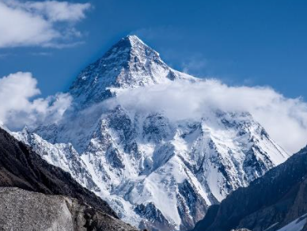
What is the landscape like?
K2
This is the second highest mountain in the world. Only Mount Everest is taller.

Slide 7
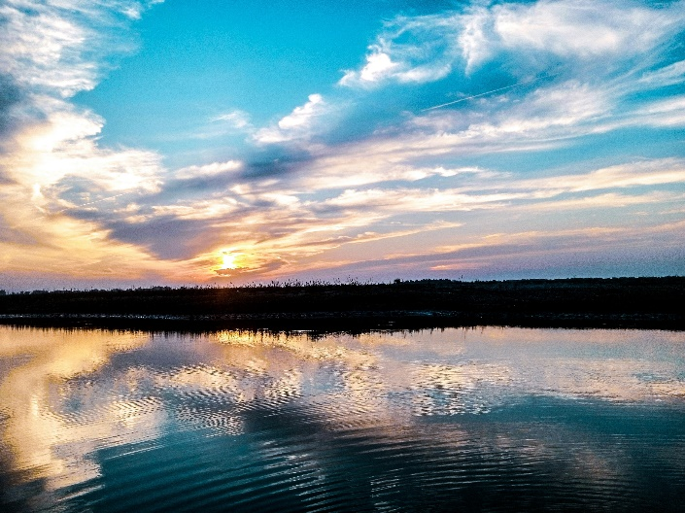
What is the landscape like?
The Indus river flows through Pakistan and into the Arabian Sea.
It is one of the longest rivers in the world.

Slide 8
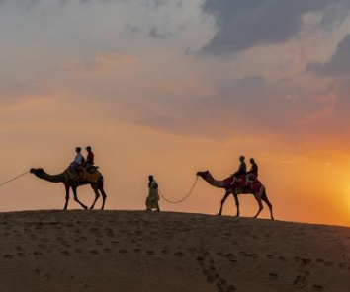
What is the landscape like?
Thar is a huge desert that is spread across both Pakistan and India.
“Thar Desert, Jaisalmer” by Ninarais licensed under CC BY 2.0 DEED

Slide 9
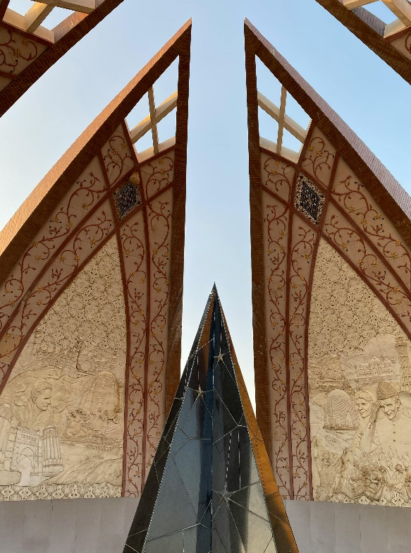
What landmarks can be seen?
The Pakistan Monument is a popular tourist destination in Islamabad.

Slide 10
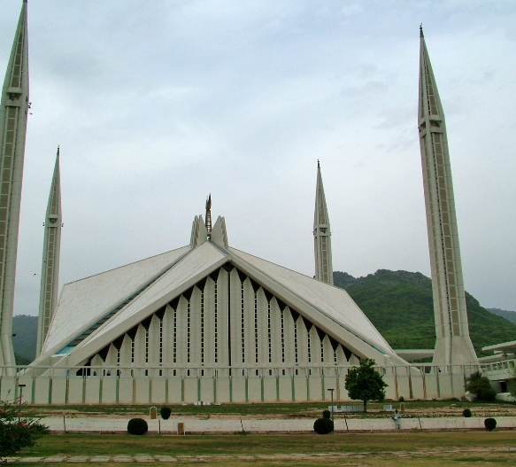
What landmarks can be seen?
Faisal Mosque is one of the largest mosques in Asia.
“Faisal Mosque” by Guilhem Vellut is licensed under CC BY 2.0 DEED

Slide 11
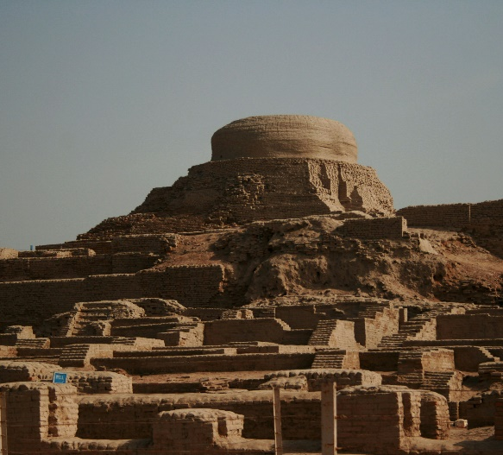
What landmarks can be seen?
Mohenjo-daro is a group of mounds and ruins on the bank of the Indus river. People lived there thousands of years ago.

Slide 12
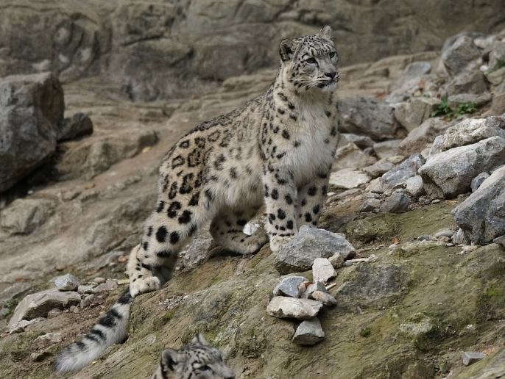
What is the wildlife like?
There are brown bears, black Himalayan bears and snow leopards in the northern mountains of Pakistan.

Slide 13
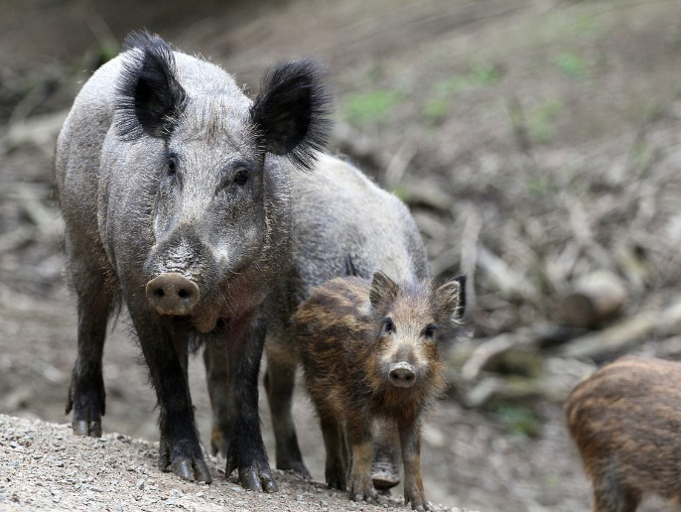
What is the wildlife like?
Crocodiles and pythons can be found near to where the Indus river flows into the Arabian Sea.
Wild boars are common in the hills near Islamabad.

Slide 14
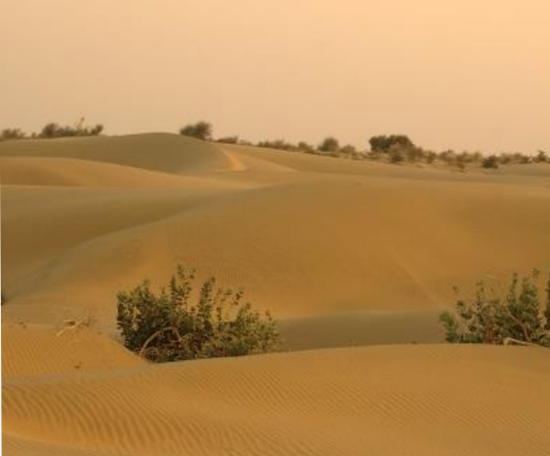
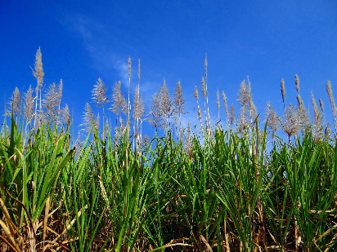
What plants can be seen?
Forests grow on mountain slopes in some areas.
Dry bushes grow in desert areas.
Wheat and sugarcane are two of the main crops.
desert bushes
“Thar Desert IV.” by Honza Soukup is licensed under CC BY 2.0 DEE
sugarcane

Slide 15
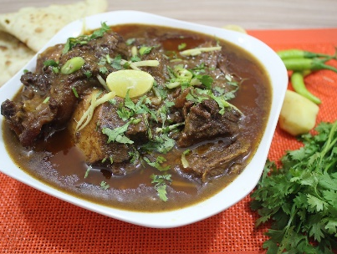
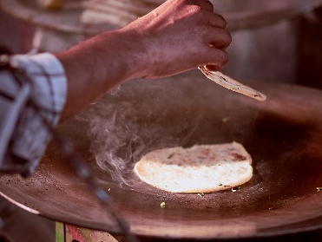
What foods are popular?
Nihari is a traditional dish. It is a slow-cooked stew.
Kulcha is a type of flatbread.
It is made with plain flour and yoghurt.
Lassi is a popular drink.

Slide 16
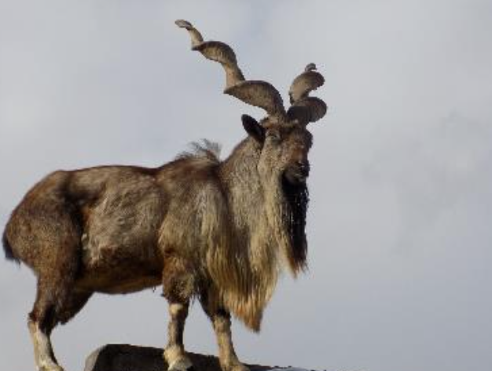
Interesting Facts
Pakistan can have a lot of earthquakes.
Their national sport is field hockey.
The national animal is a markhor. This is a type of wild goat.

Slide 17
?
Quick Quiz
1. What continent is Pakistan located on?
Asia
2. What colours are found on the flag?
green and white
3. Name a landmark.
The Pakistan Monument, the Falsal Mosque or Mohenjo-daro
4. Name a popular food.
nihari, kulcha or lassi
5. What is the national sport?
field hockey

Slide 18


